Slide 1

Neural Networks in Practice: Mini-Batches
Presented by:
Elizer Ponio Jr.
Department of Computer Science
College of Computing and Information Technologies

Slide 2
Outline
Recap of Gradient Descent
Stochastic Gradient Descent
Mini-Batch Gradient Descent

Slide 3
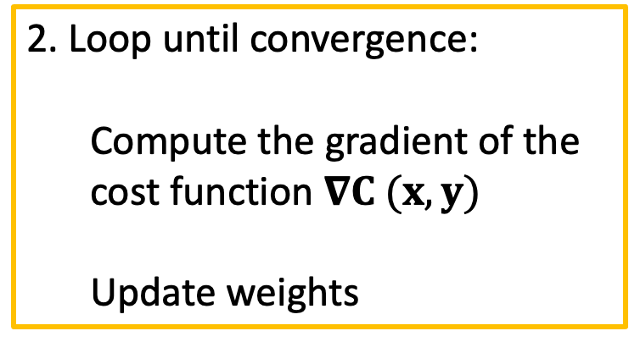
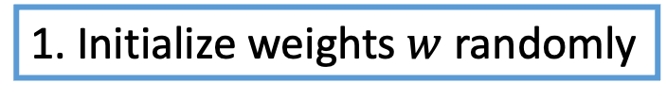
Recap of Gradient Descent
1. Initialize weights $w$ randomly
2. Loop until convergence:
Compute the gradient of the cost function $∇C (x, y)$
Update weights
3. Return weights

Slide 4




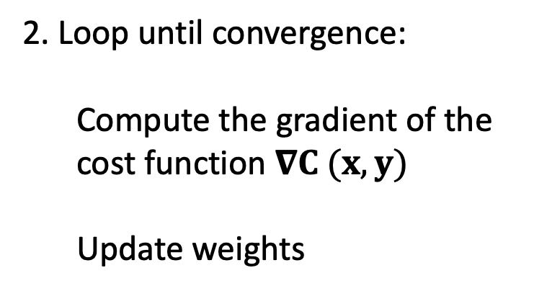


Recap of Gradient Descent
1. Initialize weights $w$ randomly
2. Loop until convergence:
Compute the gradient of the cost function $∇C (x, y)$
Update weights
$$w_{1}$$
$$w_{2}$$
$$w_{3}$$
$$0.5$$
$$1.5$$
$$0.7$$
3. Return weights

Slide 5

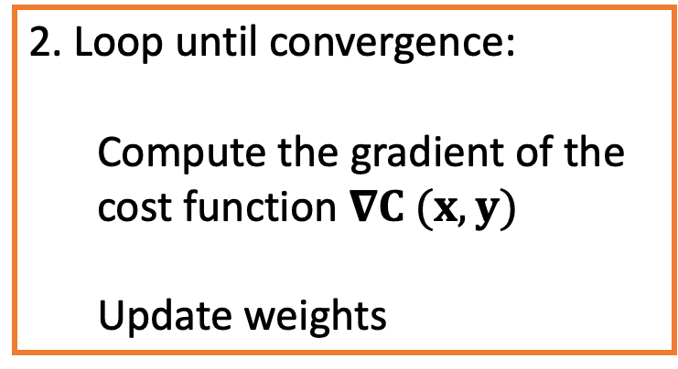
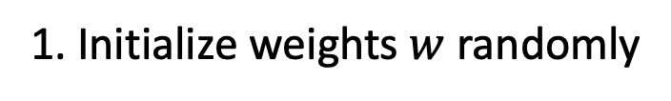
Recap of Gradient Descent
1. Initialize weights $w$ randomly
$$C (x,y)$$
2. Loop until convergence:
Compute the gradient of the cost function $∇C (x, y)$
Update weights
Initial Loss
3. Return weights
Local Minimum Loss

Slide 6
Gradient/Slope
The gradient or slope tells us the direction where it is the steepest at each point of the graph.

Slide 7
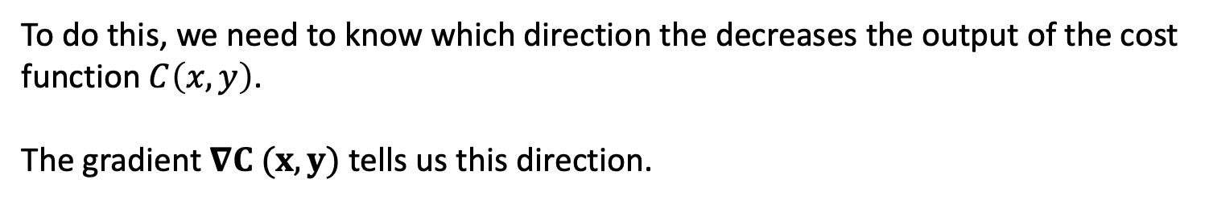
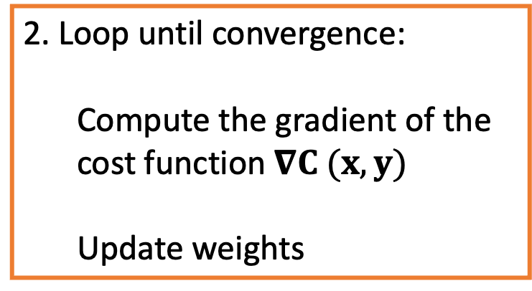
2. Loop until convergence:
Compute the gradient of the cost function $∇C (x, y)$
Update weights
The object of this step is to find the value of weights so that the loss/cost $C\left(x,y\right)$ is minimized.
To do this, we need to know which direction the decreases the output of the cost function$C\left(x,y\right)$.
The gradient $∇C (x, y)$ tells us this direction.

Slide 8






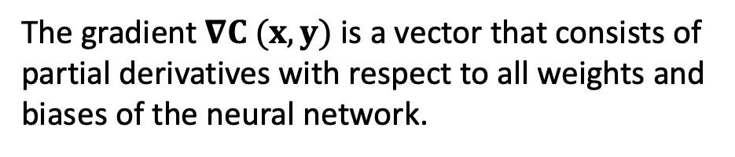



2. Loop until convergence:
Compute the gradient of the cost function $∇C (x, y)$
Update weights
$$\frac{∂C}{∂w_{1}}$$
$$\frac{∂C}{∂b_{1}}$$
$$∇C=$$
.
.
.
The gradient $∇C (x, y)$ is a vector that consists of partial derivatives with respect to all weights and biases of the neural network.
$$\frac{∂C}{∂w_{i}}$$
$$\frac{∂C}{∂w_{i}}$$
$$\frac{∂C}{∂b_{i}}$$
$$\frac{∂C}{∂w_{i}}$$
$$\frac{∂C}{∂b_{i}}$$
$$\frac{∂C}{∂b_{i}}$$
. . .

Slide 9
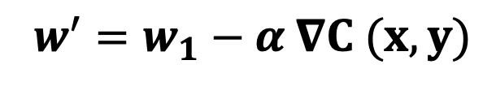
2. Loop until convergence:
Compute the gradient of the cost function $∇C (x, y)$
Update weights
Once we know the gradient, we update the weight using the formula
$$w^{′}=w_{1}−α ∇C (x, y)$$
Where $α$ is the learning rate which is a hyperparameter that determines the step size

Slide 10



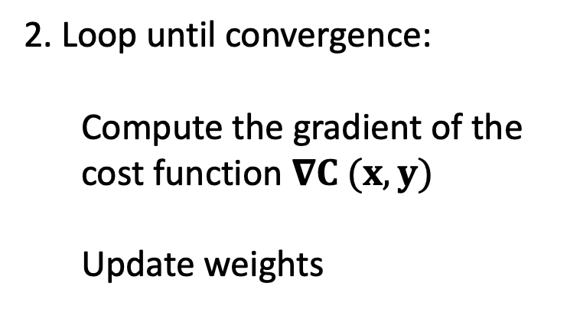
Recap of Gradient Descent
1. Initialize weights $w$ randomly
2. Loop until convergence:
Compute the gradient of the cost function $∇C (x, y)$
Update weights
$$1.2$$
$$5.5$$
$$0.9$$
3. Return weights

Slide 11
Disadvantages of Gradient Descent
There are a few downsides of the gradient descent algorithm.
Say we have 10,000 training examples and 10 features.
We need to compute the derivative of this function with respect to each of the features, so in effect we will be doing 10000 * 10 = 100,000 computations per iteration.
It is common to take 1000 epochs, in effect we have 100,000 * 1000 = 100000000 computations to complete the algorithm.
That is pretty much an overhead and this is why gradient descent is slow on huge data.

Slide 12
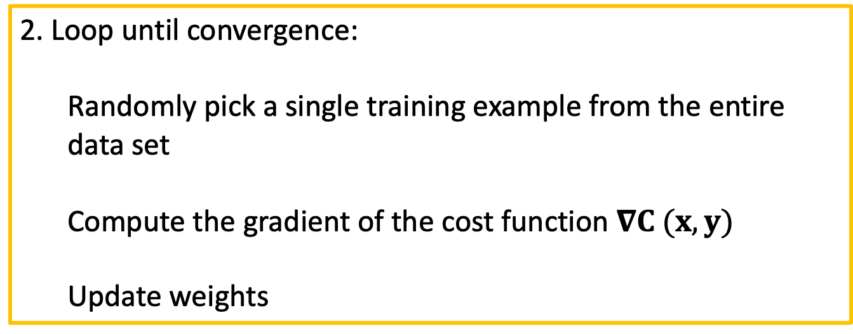

Stochastic Gradient Descent
1. Initialize weights $w$ randomly
2. Loop until convergence:
Randomly pick a single training example from the entire data set
Compute the gradient of the cost function $∇C (x, y)$
Update weights
3. Return weights

Slide 13
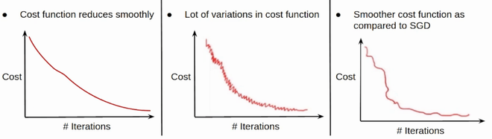
Stochastic Gradient Descent
In SGD, since only one sample from the dataset is chosen at random for each epoch, the path taken by the algorithm to reach the minima is usually noisier than your typical Gradient Descent algorithm.

Slide 14
Stochastic Gradient Descent vs Gradient Descent
 | Stochastic Gradient Descent | Gradient Descent (Batch)
Dataset Usage | Uses a single random sample or a small batch of samples at each iteration. | Uses the entire dataset (batch) at each iteration.
Computational Efficiency | Computationally less expensive per iteration, as it processes fewer data points. | Computationally more expensive per iteration, as it processes the entire dataset.
Convergence | Faster convergence due to frequent updates. | Slower convergence due to less frequent updates.
Noise | High noise due to frequent updates with a single or few samples. | Low noise as it updates parameters using all data points.
Memory | Requires less memory as it processes fewer data points at a time. | Requires more memory to hold the entire dataset in memory.

Slide 15
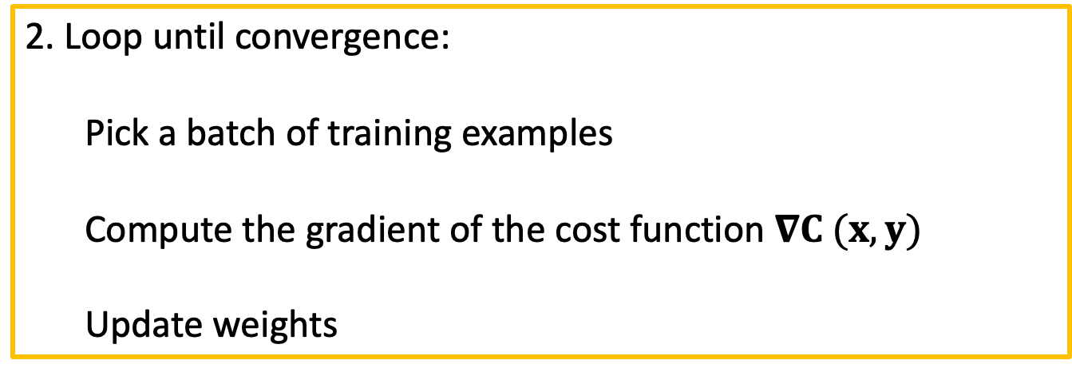
Mini-Batch Gradient Descent
1. Initialize weights $w$ randomly
2. Loop until convergence:
Pick a batch of training examples
Compute the gradient of the cost function $∇C (x, y)$
Update weights
3. Return weights

Slide 16
Mini-Batch Gradient Descent
In Mini-Batch Gradient Descent, only a subset or a mini-batch of training examples are used to compute the gradient and update the weights and biases of the neural network.
Thus, Mini-Batch gradient Descent strikes a balance between the goodness of Gradient Descent and speed of Stochastic Gradient Descent.

Slide 17
Stochastic Gradient Descent vs Gradient Descent
 | Gradient Descent (Batch) | Stochastic Gradient Descent | Mini-Batch Gradient Descent
Dataset Usage | Uses the entire dataset (batch) at each iteration. | Uses a single random sample or a small batch of samples at each iteration. | Uses a subset or mini-batch of the dataset (batch) at each iteration.
Noise | Low noise as it updates parameters using all data points. | High noise due to frequent updates with a single or few samples. | Can be less noisy depending on the batch size

